Slide 1
FARMING MADE EASY USING MACHINE LEARNING
Guided by :
Ms.V.V.Bhavani
Presented by :
Y.Harshitha 20R01A6760
P.Ruthwik 20R01A6743
S.Vaishnavi 20R01A6748
E.Priyanka 20R01A6718

Slide 2
ABSTRACT
Agriculture is the primary cornerstone of our country's economy.
In recent years because of uncertain trends in climate and other fluctuations in the price trends, the price of the crop has varied to a larger level.
Farmers, often unaware of optimal crop choices and remedies for diseases, experience significant losses.
This project addresses the development of machine learning models to make farming easy based on a comprehensive set of related features.
Through the integration of technology, this comprehensive system aims to mitigate crop losses, enhance agricultural efficiency, and establish a sustainable foundation for the farming community and positively impact the national economy.

Slide 3
INTRODUCTION
India's economy heavily relies on agriculture and agro-industry products, making it essential for the country's economic stability.
India is rapidly progressing towards technical advancements, and smart farming is emerging as a transformative force in the agricultural sector.
Farmers face challenges such as unpredictable crop prices, weather fluctuations, and limited knowledge about optimal crop choices and remedies for diseases.
The project emphasizes the transformative role of technology, particularly Machine Learning, in addressing agricultural challenges by predicting crop prices, providing weather forecasts, and offering crop and fertilizer recommendations.

Slide 4
OBJECTIVE
The aim of this project is to optimize and enhance agricultural practices through the implementation of machine learning algorithms. The project aims to predict crop prices, offer weather forecasts, recommend suitable crops and fertilizers, and provide valuable insights to farmers. By leveraging technology, the goal is to simplify decision-making, increase agricultural efficiency, and contribute to the overall prosperity of the farming community.

Slide 5
LITERATURE SURVEY
The papers presented focus on leveraging machine learning to predict crop prices and provide valuable insights for farmers.
The systems utilize historical data and various algorithms to predict profitable crops, offer user-friendly interfaces for farmers, and suggest improvements and extensions such as integration with other agricultural departments and the development of an Android application.
An easy-to-use website is developed, allowing users to predict crop yield by providing information on average precipitation and area, utilizing various data mining techniques.
The ultimate goal is to enhance accessibility, decision-making, and overall agricultural development in the country.

Slide 6
EXISTING SYSTEM
In the existing agricultural system, farmers face numerous challenges such as uncertain crop prices, unpredictable weather conditions, and limited access to comprehensive data for informed decision-making.
The lack of advanced technologies and data-driven insights often results in suboptimal agricultural practices.
Farmers may struggle to predict crop yields accurately, leading to potential financial losses.

Slide 7
LIMITATIONS OF EXISTING SYSTEM
Uncertain Crop Prices
Unpredictable Weather Conditions
Limited Data-Driven Insights
Suboptimal Agricultural Practices

Slide 8
PROPOSED SYSTEM
The proposed system introduces a transformative approach to address the challenges in the existing agricultural system.
Using machine learning, the system seeks to offer farmers precise predictive analytics, accurate crop yield forecasts, and instant insights.
It incorporates modules for predicting crop prices, offering weather forecasts, recommending suitable crops and fertilizers, and facilitating seamless communication among farmers.
Proposed system extensions include modules to aid farmer decision-making based on harvested area and market trends, visualizing crop details in maps, and graphical representations of predicted prices.

Slide 9
PROPOSED SYSTEM
MODULES:
1) New Farmer Sign Up: Using this module farmers can signup with application
2) Farmer Login: Farmer can login to application by using username and password given at signup time and then farmer can select crop name to get its predicted prices in different market. Farmer can view all schemes details launched from the government
3) Admin Login: Admin can login to application by using ‘admin’ as username and password and then can add new schemes details

Slide 10
ADVANTAGES OF PROPOSED SYSTEM
Improved Decision-Making
Enhanced Agricultural Productivity
Reduction in Financial Losses
Seamless Communication and Information Exchange
Accessibility to Predictive Analytics

Slide 11
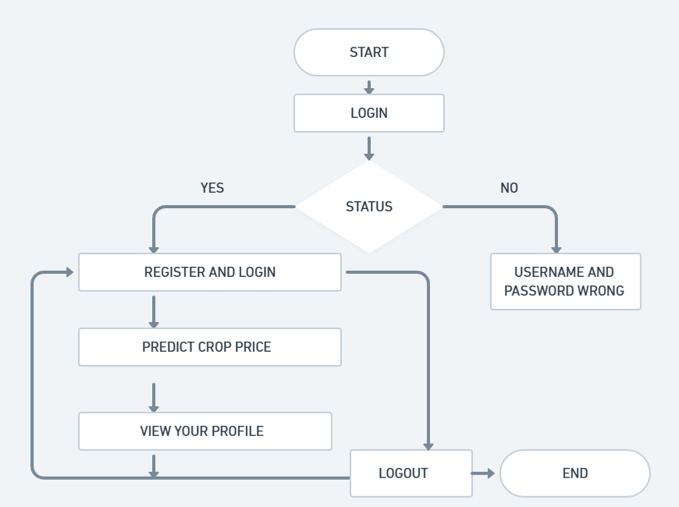
SYSTEM ARCHITECTURE
REMOTE USER FLOWCHART

Slide 12
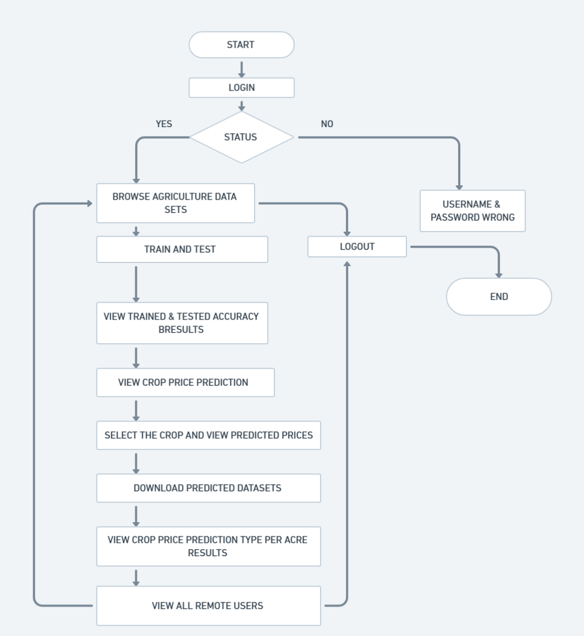
SERVICE PROVIDER FLOWCHART

Slide 13
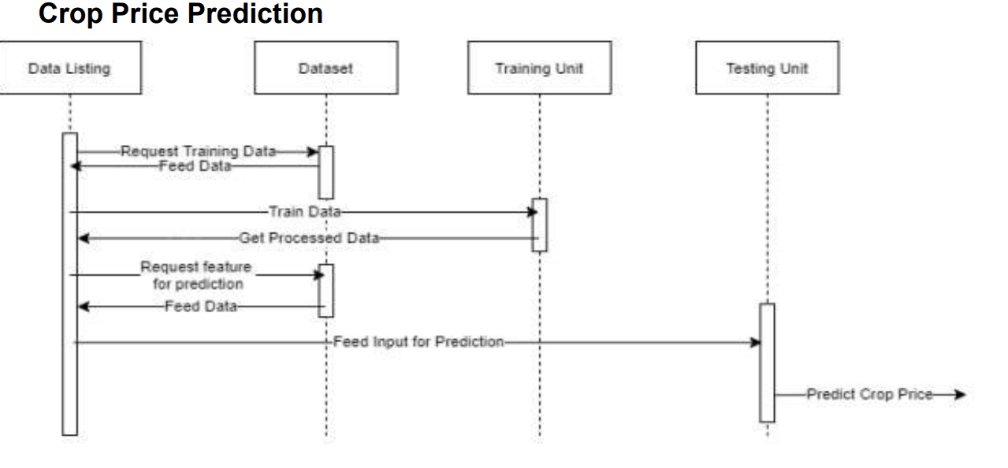
SEQUENCE DIAGRAM

Slide 14
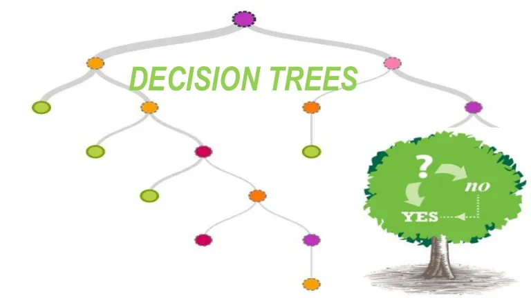
ALGORITHM
DECISION TREE
A decision tree algorithm is a machine learning technique that visually represents decisions and their possible consequences as a tree-like structure, making it useful for both classification and regression tasks. It works by dividing data into smaller subsets based on input features, creating a tree structure of decisions to predict outcomes.

Slide 15
PARAMETERS
1.Timestamp
2.District
3.Market
4.Commodity
5.Variety
6.Arrival date
7.Minimum Price
8.Maximum Price
9.Rainfall

Slide 16
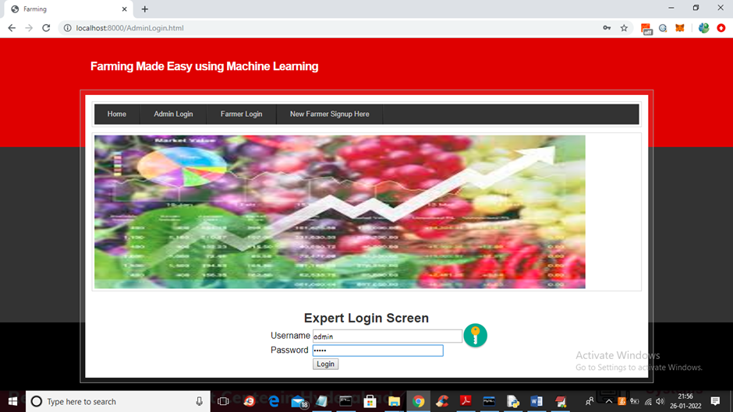
RESULTS
Login page

Slide 17
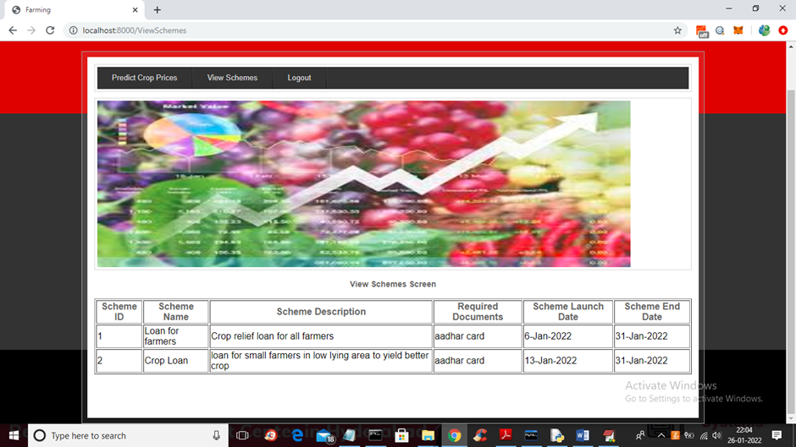
RESULTS
View Schemes

Slide 18
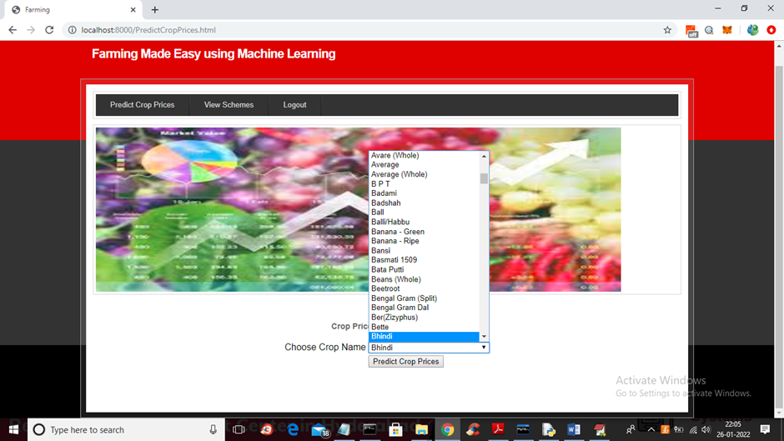
RESULTS
Predict Crop Prices

Slide 19
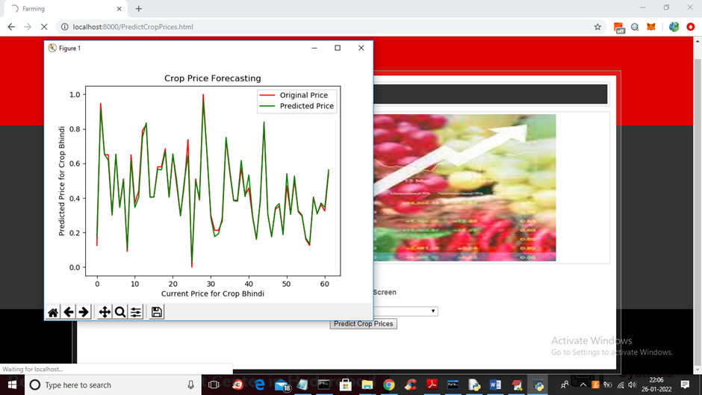
RESULTS
Crop Price Forecasting

Slide 20
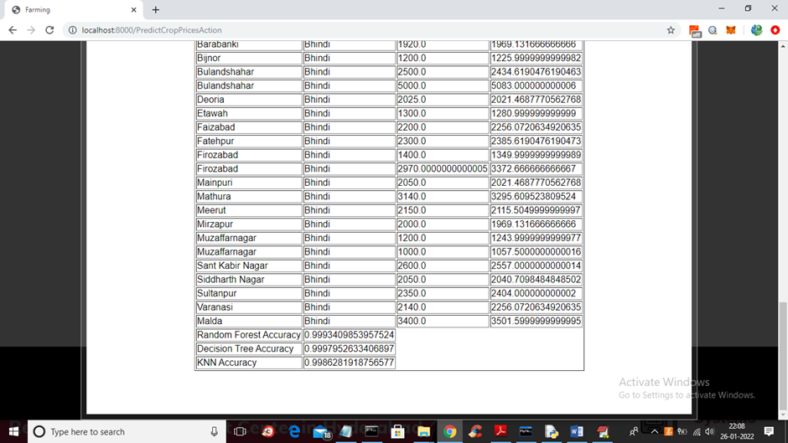
RESULTS
Accuracy and Prediction Prices

Slide 21
CONCLUSION
In conclusion, our project uses cutting-edge technology to revolutionize agriculture, providing farmers with advanced predictive analytics using machine learning algorithms like KNN, Naive Bayes, and Decision Tree. The web application, known for its simplicity, shows that Decision Tree outperforms other algorithms, achieving over 90% testing accuracy. Witnessing the project's positive impact on improving yields and reducing losses highlights technology's transformative role in shaping the future of agriculture.

Slide 22
FUTURE ENHANCEMENT
Expanded Crop Portfolio:
Include a broader range of crops in the predictive models, considering regional variations and diverse agricultural practices to cater to a wider audience.
Localized Pest and Disease Prediction:
Develop models for predicting localized pest and disease outbreaks, enabling farmers to take preventive measures and reduce crop losses.
Mobile Application Development:
Create a mobile application for on-the-go access, enabling farmers to receive notifications, access insights, and make decisions from their smartphones.

Slide 23
FUTURE ENHANCEMENT
Collaboration with Agricultural Research Institutions:
Collaborate with agricultural research institutions to incorporate the latest scientific advancements into the predictive models and recommendations.
Machine Learning Model Optimization:
Continuously optimize machine learning models by incorporating new algorithms, refining existing ones, and staying updated with the latest advancements in the field.

Slide 24
REFERENCES
[1] Rachana, Rashmi, Shravani, Shruthi, Seema Kousar, Crop Price Forecasting System Using Supervised Machine Learning Algorithms, International Research Journal of Engineering and Technology (IRJET), Apr 2019
[2] Nishiba Kabeer, Dr.Loganathan.D, Cowsalya.T, Prediction of Crop Yield Using Data Mining, International Journal of Computer Science and Network, June 2019
[3] J. Vijayalakshmi, K. PandiMeena, Agriculture TalkBot Using AI, International Journal of Recent Technology and Engineering (IJRTE), July 2019
[4] Gamage, A., & Kasthurirathna, D. Agro-Genius: Crop Prediction Using Machine Learning, International Journal of Innovative Science and Research Technology, Volume 4, Issue 10, October – 2019

Slide 25
THANK YOU

